Slide 1




Topic 2
PROJECT INITIATION AND PLANNING
SYSTEMS ANALYSIS AND DESIGN

Slide 2



CONTENT
SEGI UNIVERSITY
01
Understand project initiation and planning
02
Identify and select systems projects
03
Conduct feasibility analysis
04
Analyze and manage project risks

Slide 3
Introduction
IT is a fast changing industry. Each year, we see evolutionary developments in current technology, such as faster processors, wider network coverage and bandwidth, bigger storage capability, autonomous processes, enhanced cybersecurity
System Analyst should be aware of current trends in IT so that they can better serve their companies and adapt their skill sets
Business is also another dynamic and fast changing industry. Modern businesses have shifted from traditional face-to-face services to global digitalise business, such as e-commerce, m-commerce, etc.
IT team should be aware of current business operational mode so that they can understand and support the firm’s long-term strategic goals

Slide 4
INTRODUCTION TO PROJECT INITIATION AND PLANNING
A project is identified when someone in the organization identifies a business need to build a system.
A need may surface when an organization identifies unique and competitive ways of using it.
To leverage the capabilities of emerging technologies

Slide 5
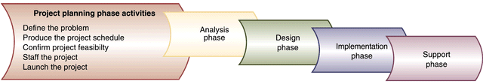
Project Planning Activities

Slide 6
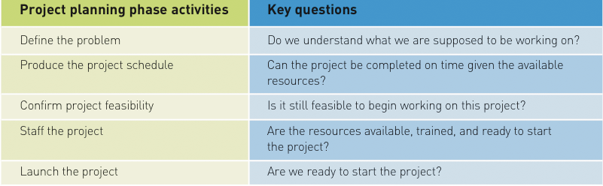
Project Planning Activities and their key questions

Slide 7
Business Process Management (BPM)
BPM is a methodology used by organizations to continuously improve end-to-end business processes.

Slide 8
PROCESS OF BPM
Defining and mapping the steps in a business process.
Creating ways to improve on the steps in the process that add value
Finding ways to eliminate or consolidate steps in the process that do not add value
Creating and adjusting electronic workflows to match the improved process maps.

Slide 9
Types of Business Process
Business process automation (BPA)
Technology components are used to complement or substitute manual process.
Business process improvement (BPI)
Creating new, re-designed processes to improve the workflows, and/or utilizing new technologies enabling new process structures.
Business process reengineering (BPR)
Changing the fundamental way in which the organization operate.

Slide 10
The starting point for most
IT projects is upon the receipt of a systems request …

Slide 11
What is Systems Request ?
A system request is a formal document or proposal submitted by a user, department, or manager to the IT department (or system development team) to start the process of developing, modifying, or improving an information system.
It’s usually the first step in the System Development Life Cycle (SDLC) because it signals the need for a new system or changes to an existing one.
The document that describes the business reasons for building a system and the value that system is expected to provide.

Slide 12
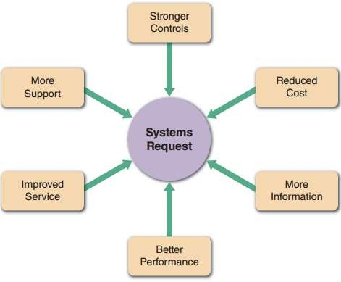
Why systems request ?
Stronger controls
To ensure that data is secure and accurate
Reduced cost
To reduce the expense of the current system
More information
To provide information for major decision- making on planning, designing and marketing new products and services
Better performance
To provide better performance than the current
system
Improved service
To improve customer services within the company
Source: Shelly Cashman (2016), p. 46
More support
To provide support for new products and services

Slide 13
Business Needs
Reasons
Examples
Stronger controls
Security controls include passwords, data encryption/decryption. Physical controls include biometric devices, fences and gates. Data controls include a variety of data validation checks
Reduced cost
A cost-benefit analysis to compare if the new system is more cost effective and provide better support for long- term objectives than the current system
More information
A package tracking system that tracks customers’
parcels and predicts market trends
Better performance
An ATM system that able to complete a withdrawal transaction within 2 minutes
Improved service
An online leave application system allows users to check
their used and remaining annual leaves
More support
A package delivery company might add a special service for RFID-tagged shipments for their customers
Notes:
The business-related reason for initiating the system.
For example:
increase sales
improve market share
improve access to information
improve customer service
decrease product defect
streamline supply acquisition, processes.

Slide 14
BUSINESS REQUIREMENTS
The business requirements of the project refer to the business capabilities that the system will need to have.
For example:
Provide online access for information
Capture customer demographic information
Include product search capabilities
Produce management report
Include online user support

Slide 15
BUSINESS VALUE
The business value describes the benefits that the organization should expect from the system.
For example:
3% increase in sale
1% increase in market share

Slide 16









Factors that initiates a system project
Suppliers
Customers
E
x t e r n a l
Strategic plan
I
n t e r n a l
Top managers
User requests
Technology
Competitors
f a c t
IT
departme
nt
f a c t
Existing systems & data
o
Source: Extracted and modified from Shelly Cashman (2016), p. 48
r s
o
r s
Company finances
Government
Economy

Slide 17
Internal factors for system project
Strategic plan – a strategic plan that emphasises technology tends to create a favourable climate for IT projects that extends throughout the organisation
Top managers – top management usually initiates large-scale projects that resulted from strategic business goals that require new IT systems
User requests – users are more heavily rely on IS to perform their daily tasks
and are likely to request more IT services and support
IT department – IT staff members make recommendations based on their knowledge of business operations technology trends
Existing systems and data – problems in existing system can trigger requests
for system project
Company finances – a company’s financial status can affect whether the requests for system project to be accepted

Slide 18
External factors for system project
Customers – IS that interact with customers usually receive top priority. Implement CRM to have better controls on all customer-related events and transactions
Competitors – Competition drives many IS decisions to ensure the firm remains competitive in the market
Economy – Economy activity has a strong influence on corporate information
management
Government – Government regulations directly affect the design of corporate IS
Technology – Rapid growth of technology creates new industries, reshapes a
company’s overall mission and day-to-day operations
Suppliers – Significant growth of e-commerce makes the relationships between providers and suppliers critically important

Slide 19
Key Features of a System Request
Initiated by users or management – not usually by the IT team itself.
Defines the problem or opportunity that the system should address.
Outlines the proposed system’s objectives (e.g., faster processing, better reporting, improved customer service).
Provides reasons for the request (e.g., inefficiency in current system, compliance needs, competitive advantage).
Summarizes expected benefits (e.g., cost savings, productivity improvements).
Often includes constraints or special requirements (e.g., deadline, budget, regulatory compliance).

Slide 20
Common Contents of a System Request
Project sponsor / requester (who is making the request)
Business need / problem statement
System objectives or goals
Expected benefits (tangible and intangible)
Constraints (time, budget, regulations, technology)
Proposed scope (initial idea of what the system should cover)
Example
A sales manager submits a system request to the IT department asking for a new Customer Relationship Management (CRM) system to improve customer tracking and reporting, citing lost sales opportunities due to the limitations of the current system.

Slide 21
What is business case ? Why it is important ?
Business case refers to the reasons or justification, for a business proposal
It determines whether or not a proposal is accepted by the IT team during systems planning phase
A strong business case suggests that the company should pursue the alternative, above other options, because it would be in the firm’s best interest to do so
Therefore, the SA must consider the company’s overall mission, objectives and IT needs

Slide 22
Evaluating a systems request
When a systems request form is received, a SA / IT manager determines the required IT resources for the request
Then, a designated approval committee decides whether to proceed with a preliminary investigation
Evaluate the request
Forms by IT manager / director and representatives from other departments within the organisation
Provides a variety of experience and knowledge
A mission-critical request will require an immediate response

Slide 23

Preliminary Investigation

Slide 24
What is preliminary investigation ?
Preliminary investigation is a sequence of processes to study the systems request and to recommend specific action
Emphasises on the following 4 areas that drew the attention from all businesses:
Problem or Opportunity
Project scope and constraints
Benefits
Costs

Slide 25
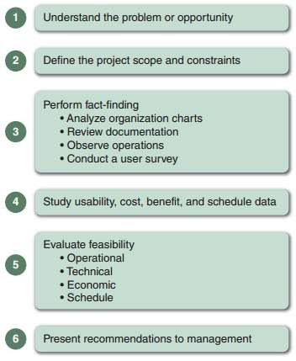
Steps in preliminary investigation
The exact procedure depends on the nature of the request, the project size and the degree of urgency
A systems request must pass a feasibility study in order to proceed
Source: Shelly Cashman (2016), p. 58

Slide 26
FEASIBILITY ANALYSIS
Feasibility analysis or Feasibility Study is an assessment of the practicality of a proposed plan, project or method
Feasibility analysis guides the organization in determining whether to proceed with a project.
Feasibility analysis also identifies the important risks associated with the project that must be managed if the project is approved.

Slide 27
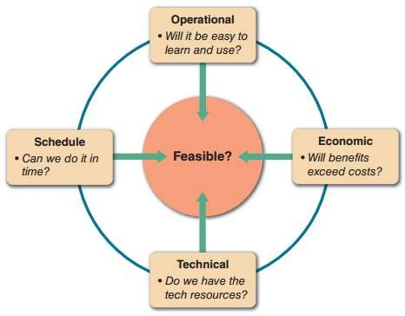
FEASIBILITY ANALYSIS (cont)
As with the system request, each organization has its own process and format for the feasibility analysis, but most include techniques to assess four areas:
Technical feasibility
Economic feasibility
Organizational feasibility
Schedule feasibility
The results of evaluating these four feasibility factors are combined into a feasibility study deliverable that is submitted to the approval committee at the end of project initiation.

Slide 28
Technical Feasibility
Technical feasibility is the extent to which the system can be successfully designed, developed, and installed by the IT group.
It is, in essence, a technical risk analysis that strives to answer the question: “can we build it?”
Risks can endanger the successful completion of a project. The following aspects should be considered:
Users’ and analysts’ should be familiar with the application.
Familiarity with the technology
Project size
Compatibility of the new system with the technology that already exists

Slide 29

Economic Feasibility
Economic feasibility analysis is also called a cost-benefit analysis, that identifies the costs and benefits associated with the system.
This attempts to answer the question: “should we build the system?”

Slide 30
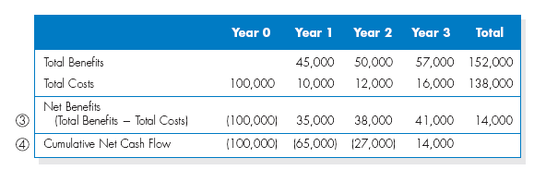
CASH FLOW ANALYSIS AND MEASURES
IT projects involve an initial investment that produces a steam of benefits over time, along with some on-going support costs.
Cash flows, both inflows and outflows, are estimated over some future period.
Simple cash flow projection

Slide 31
ORGANIZATIONAL FEASIBILITY
Organizational feasibility of the system is how well the system ultimately will be accepted by its users and incorporated into the ongoing operations of the organization.
There are many organizational factors that can have an impact on the project, and seasoned developers know that organizational feasibility can be the most difficult feasibility dimension to assess.
In essence, an organizational feasibility analysis is to answer the question “if we build it, will it benefit the organisation?”

Slide 32
ORGANIZATIONAL FEASIBILITY (cont)
One way to assess the organizational feasibility is to understand how well the goals of the project align with the business objectives and organizational strategies.
A second way to assess the organizational feasibility is to conduct stakeholder analysis.

Slide 33
Stakeholder
A stakeholder is any person who has an interest in an existing or new system. Stakeholders can be technical or non-technical workers
Stakeholders can be classified as:
System owners
System users
Systems analysts
System designers
System builders (programmers!)
IT vendors and consultants

Slide 34
System Owners
Main project sponsors
Responsible for funding the project to develop, operate and maintain the system
May select the project manager
Involved in allocating resources to and overseeing system development projects
Notes:
May have a direct role in systems development if project is small

Slide 35
System Users
People who use or are affected by the system
Internal users are those employed by the company
Clerical and service workers
Technical and professional staff
Supervisors, middle managers, and executive managers
Remote and mobile users (internal but disconnected)
External users refer to third parties such as customers or other organisations

Slide 36
SCHEDULE FEASIBILITY
Schedule feasibility assesses whether a proposed project can be completed within the required timeframe. It examines the project timeline, deadlines, resources, and dependencies to determine if the system can realistically be delivered on time.
Key Question: “Can we finish the project within the deadline?”
Factors Considered: project complexity, team size and skills, available technology, and external constraints (e.g., regulatory or market deadlines).
Risk: If the timeline is unrealistic, it may lead to rushed work, poor quality, or even project failure.

Slide 37
Managing Risk
Risk management is the identification, assessment, and prioritization of risks followed by coordinated and economical application of resources to minimize, monitor, and control the probability and/or impact of unfortunate events or to maximize the realization of opportunities.
Risk management’s objective is to assure uncertainties does not affect the business goals.

Slide 38
Managing Risk
Identify Risk
Risk assessment
Actions to reduce risk

Slide 39
1. Identify the risks
Risk identification lists each risk and assesses the likelihood that it could affect the project.
The details would depend on the specific project, but most lists would include a means of identification, and a brief description of the risk, what might cause it to occur, who would be responsible for responding, and the potential impact of the risk.

Slide 40
1. Identify the risks (cont.)
Risks can come from various sources including uncertainty in financial markets, threats from project failures (at any phase in design, development, production, or sustainment life-cycles), legal liabilities, credit risk, accidents, natural causes and disasters, deliberate attack from an adversary, or events of uncertain or unpredictable root-cause.
There are two types of events:
Negative events can be classified as risks,
Positive events are classified as opportunities.

Slide 41
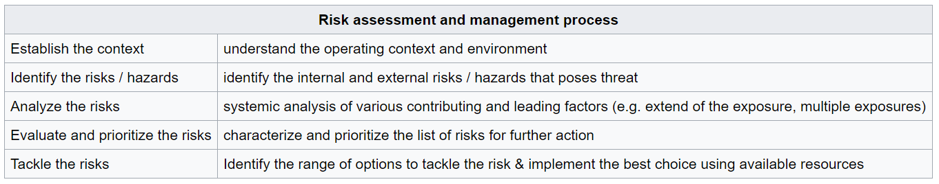
2. Risk assessment
Risk assessment is the determination of estimate of risk related to a well-defined situation and a recognized threat (also called hazard).
Five steps process of risk assessment:

Slide 42
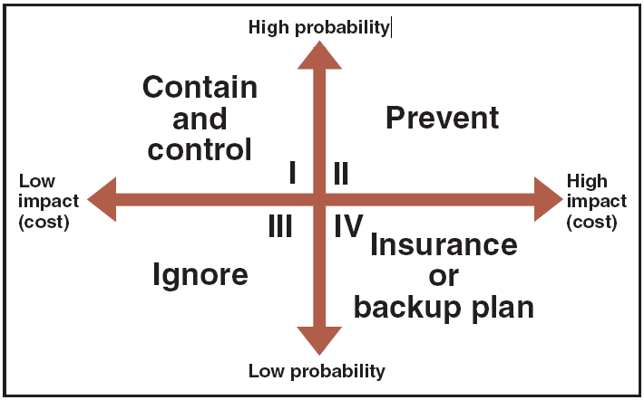
Analyze the risks
This typically is a two-step process:
Qualitative risk analysis evaluates each risk by estimating the probability that it will occur and the degree of impact.
Quantitative risk analysis is to understand the actual impact in terms of dollars, time, project scope, or quality.

Slide 43
3. Actions to reduce risk
Design a new business process with adequate built-in risk control and containment measures from the start.
Periodically re-assess risks that are accepted in ongoing processes as a normal feature of business operations and modify mitigation measures.
Transfer risks to an external agency (e.g. an insurance company)
Avoid risks altogether (e.g. by closing down a particular high-risk business area)

Slide 44
 | Activity | Hazard | Existing Controls | Risk | Further Possible Measures
1 | Sliding of paper chart whiteboards | Derailed and/or dropped whiteboard | The installation company has checked that they are properly installed and has recommended ‘usage with care’ | 2x2=4 | - Ensure that their ‘hooks’ are sitting on the appropriate rail (not close to the wall) - Install an extra guard to run along the top of the rail that will not allow derailment or unhooking. - Abolish them altogether - Replace them with a full size whiteboard to be hanged by the inner rail (non removable slides) that may also carry the paperclips.
2 | Using the computers in room CIB112 | Physical injury due to lack of desktop space between keyboard and user for resting the wrists | Use continuously only for limited time (below 20 minutes) | 2x2=4 | - Change desks for deeper ones - Remove computers from the room
3 | Usage of room CIB 213 | Physical injury or delayed evacuation due to limited space in the room at the entrance | Remove the two computers closest to the door | 3x1=3 | Remove the desk closest to the door
4 | Call for help in case of an emergency | Not being able to contact Security or a person trained in First Aid | Use own mobile phone | 3x2=6 | Install a few phones with internal calls capability on each floor
5 | Emergency evacuation | Delayed evacuation due to the main staircase being overcrowded | Use also both the staircases at the far ends of the building | 1x3=3 | Instruct all members of staff not to use the main staircase, during an evacuation, at all and take their students with them (let only the unaccompanied students and visitors to use the main staircase).
Risk = Impactx likelihood |  |  | Result |  | Date ………………….
Impact | Rating | Likelihood | Risk | Rating
Death or Serious Injury | 3 | Certain | High | 6 or 9 | Assessment completed by ………………….
Everything Else | 2 | Everything Else | Medium | 3 or 4
Minor or no injury | 1 | Almost never | Low | 1 or 2 | Signature ……………………

Slide 45
A good proposal should cover …
Motive
Why are we doing this project?
Purpose / Aim
What is the project about?
Objectives
How does this solution address key business issues?
Time management & Risk management
How much will it cost and how long will it take? Will we suffer a productivity loss during the transition? What are the risks of doing the project? What are the risks of not doing the project?
Evaluation & Rewards
How will we measure success? What is the return on investment and payback period?

Slide 46
Project Selection
An approval committee must be selective about where to allocate resources as most organizations have limited funds.
If there are several potentially high-payoff projects, and they all have the same risk, then maybe only one of the projects will be selected.

Slide 47
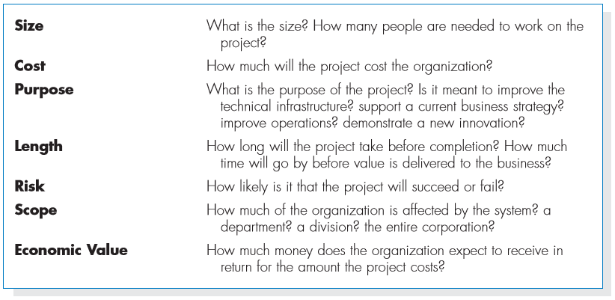
Ways to Classify Projects

Slide 48
SUMMARY
Project Initiation
Begins with a System Request (formal proposal for new or improved system).
Must align with business needs and strategic goals.
Reasons for System Request
Stronger controls, reduced cost, better performance, improved service, more support, more information.
Business Case
Justifies why the project is needed.
Considers mission, objectives, benefits, and risks.
Preliminary Investigation
Examines: problem/opportunity, scope & constraints, benefits, and costs.
Involves Feasibility Analysis.
Types of Feasibility
Technical – Can we build it?
Economic – Should we build it?
Organizational – Will it be accepted?
Schedule – Can we finish it on time?
Risk Management
Identify risks, assess impact (qualitative & quantitative), and take mitigation actions.

